Slide 1







#BeraniBedaItuBaik
#KesehatanMentalItuPenting
Scenario Test Case
Website Small Project QA13
with Robot IDE (RIDE)
KETUA PELAKSANA OLEH Hadi
sponsor media partner

Slide 2

List
Test
Scenario
01
BOOKING WITH LOGIN PAY BY BANK WIRE
User can booking hotel with login via Bank Wire Payment.
02
BOOKING WITH LOGIN PAY BY CHECK
User can booking hotel with login via Check Payment.
03
BOOKING WITHOUT LOGIN PAY BANK WIRE
User can booking hotel without login via Bank Wire Payment.
04
BOOKING WITHOUT LOGIN PAY BY CHECK
User can booking hotel without login via Check Payment.
05
FEATURE WEBSITE
User can try some of the features available on the Small Project QA13 Website.
06
NEGATIVE TEST CASE
Errors that may be made by user.

Slide 3
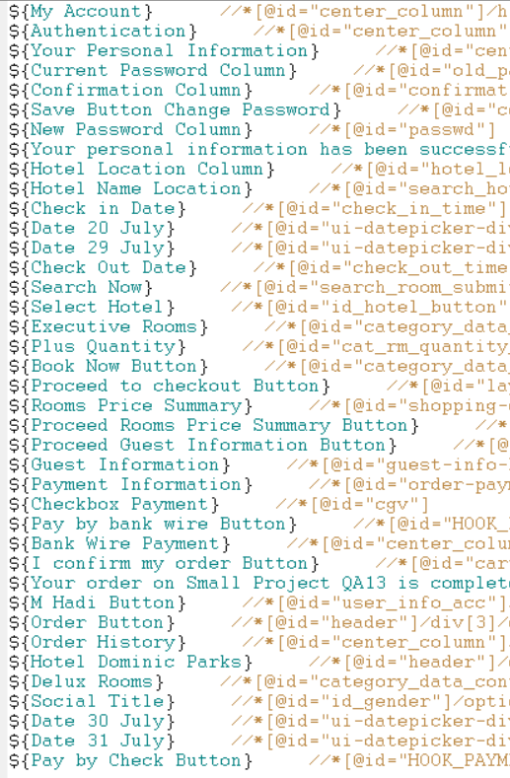
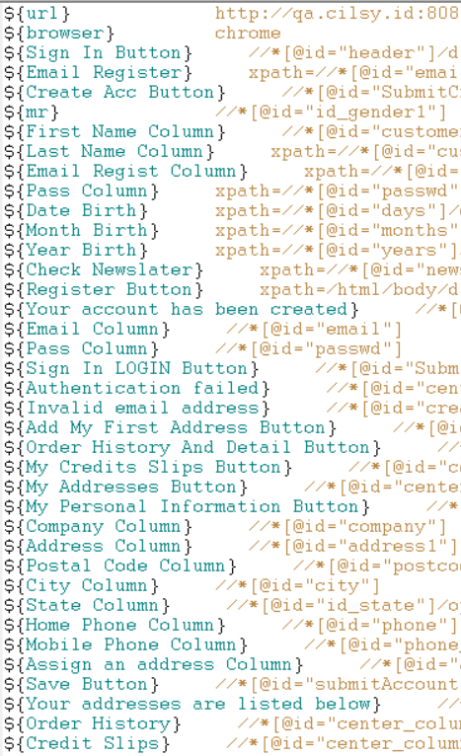
Total Variable
77 Scalar

Slide 4
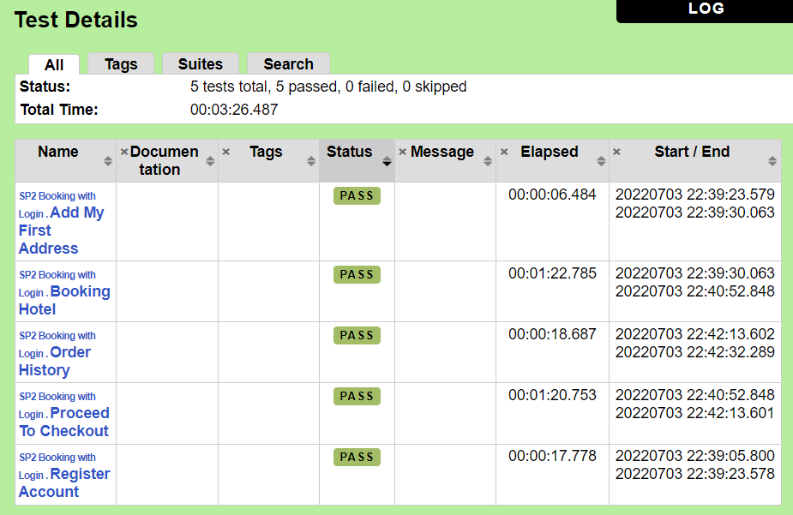
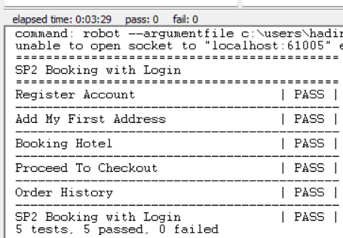
BOOKING WITH LOGIN PAY BY BANK WIRE
SUCCESS

Slide 5
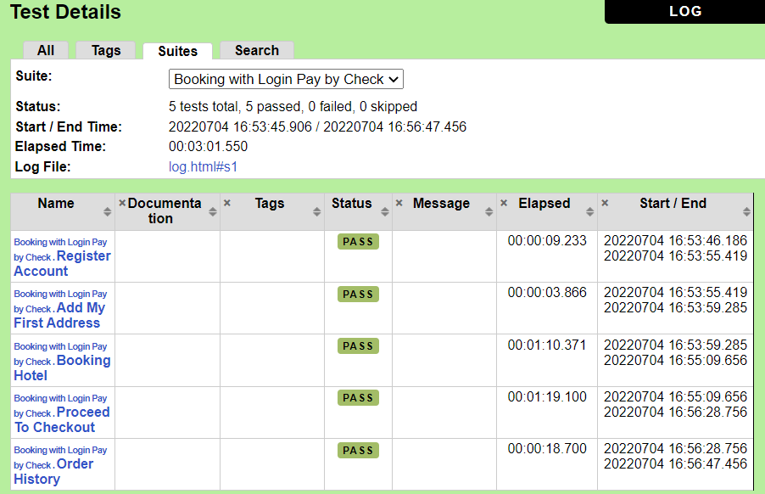
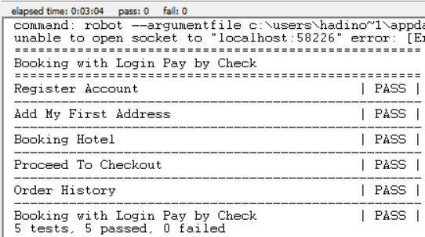
BOOKING WITH LOGIN PAY BY CHECK
SUCCESS

Slide 6
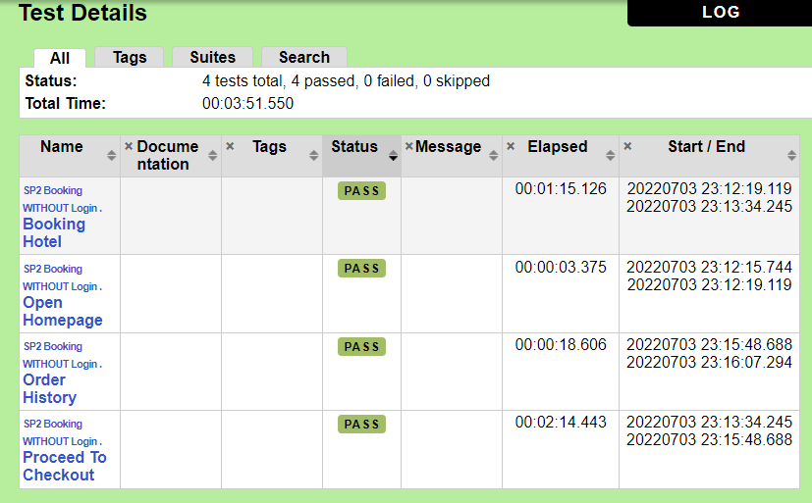
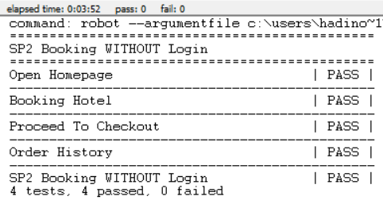
BOOKING WITHOUT LOGIN PAY BANK WIRE
SUCCESS

Slide 7
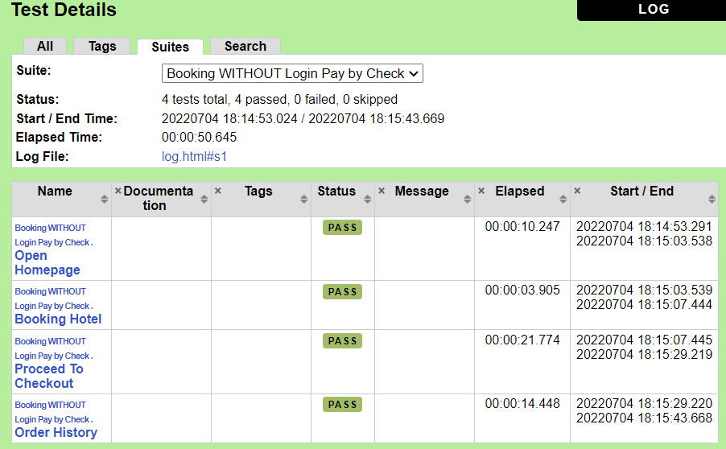
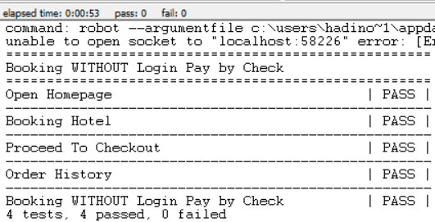
BOOKING WITHOUT LOGIN PAY BY CHECK
SUCCESS

Slide 8
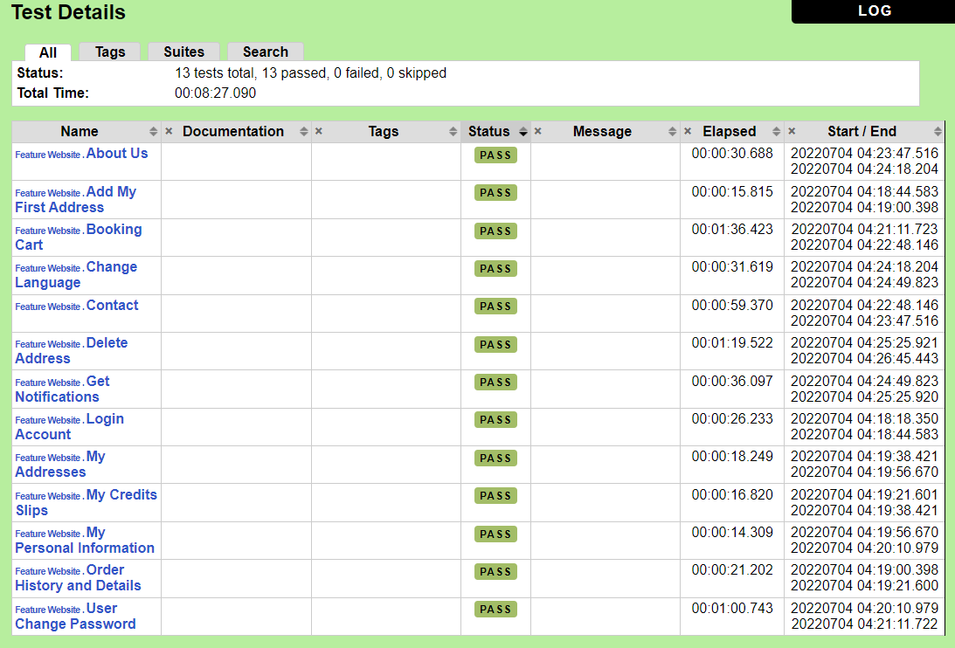
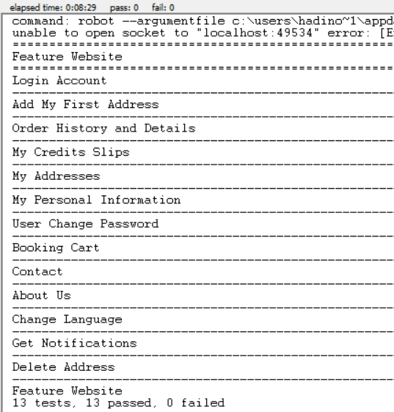
FEATURE WEBSITE
SUCCESS

Slide 9
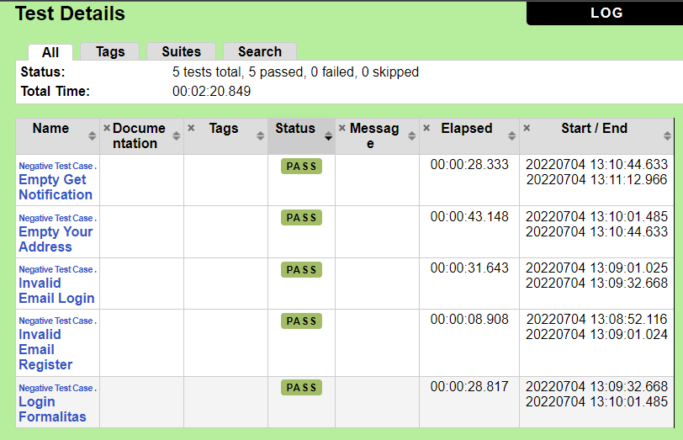
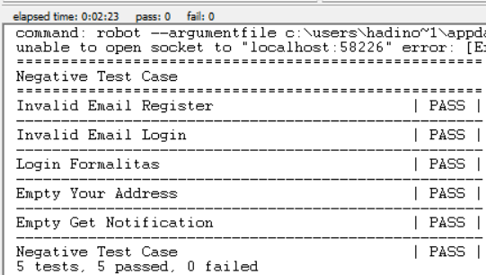
NEGATIVE TEST CASE
SUCCESS

Slide 10
Strengths & Weaknesses
positive
negative
User interface frindly
Simple than selenium
If an error, it will be notified of the wrong line or element
RIDE application is lighter than IntelliJ IDEA
RIDE Application Suitable for Simple Project
See the report easier
If there are too many variables, i have a headache
Settings, Variables, and Test Case are on 1 page (crowded)
The reach of solved problems is small in scope
No dark mode
Dependence with python

Slide 11
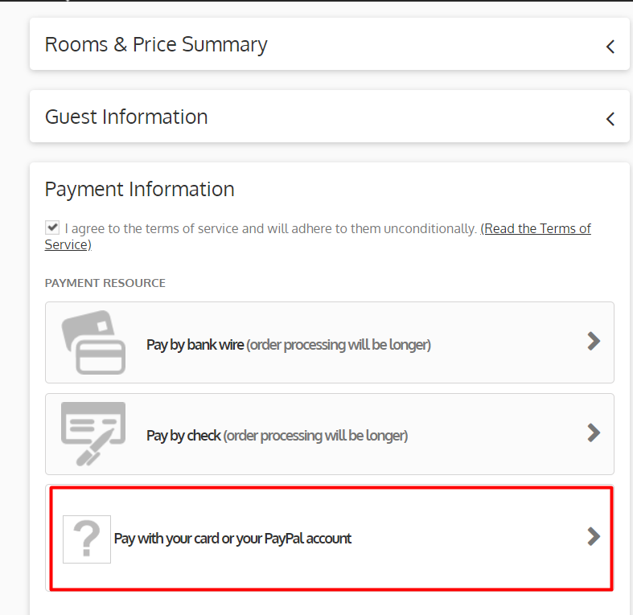
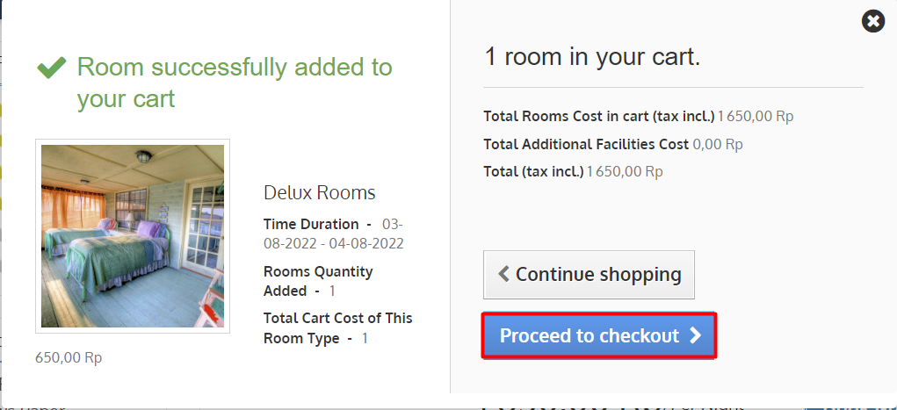
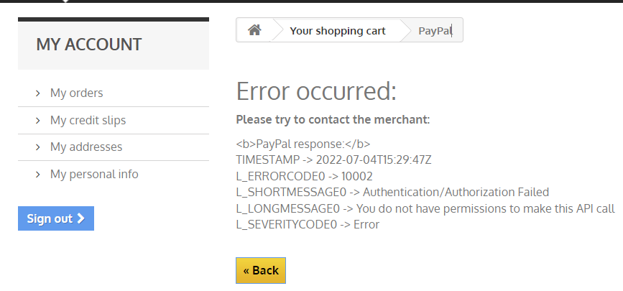
Bug

Slide 12
thank you
kurang lebihnya mohon dimaafkeun ini mah…

